Slide 1
Chapter-1
Integration
Indefinite Integrals
Definite Integrals

Slide 2
1.1Indefinite Integrals

Slide 3
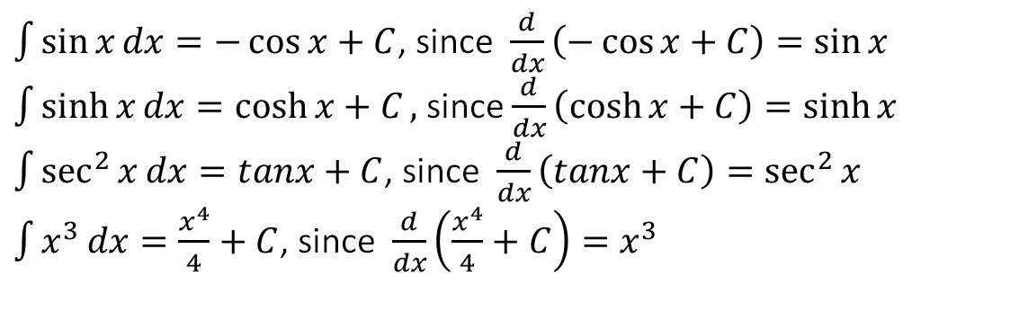
1.1.1 Definition of Indefinite Integrals
Indefinite integration may be regarded as the inverse operation to differentiation. This means that the derivative of an indefinite integral of a function is the function itself.
Given a function $f(x)$ and $F(x)$ is an anti-derivative of $f\left(x\right)$such that $F^{′}\left(x\right)=f(x)$. Then$F(x)$ is said to be indefinite integral or anti derivative of $f\left(x\right)$ ,which can be written as
Here, is called integral symbol, $f(x)$ is called integrand, $x$ is called integration variable and $C$ is called constant of integration.
Example 1.1.1
$\int{\sin{x}}dx=−\cos{x}+C$, since $\frac{d}{dx}\left(−\cos{x}+C\right)=\sin{x}$
$\int{\sinh{x}dx=\cosh{x+C},}$ since $\frac{d}{dx}\left(\cosh{x}+C\right)=\sinh{x}$
$\int{\sec^{2}{x}}dx=tanx+C$, since $\frac{d}{dx}\left(tanx+C\right)=\sec^{2}{x}$
$\int{x^{3}}dx=\frac{x^{4}}{4}+C$, since $\frac{d}{dx}\left(\frac{x^{4}}{4}+C\right)=x^{3}{}$

Slide 4
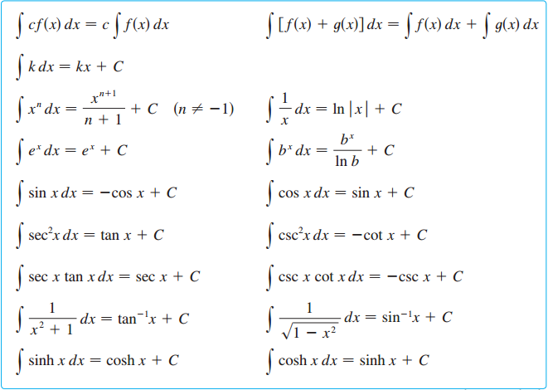
Integral properties and table of indefinite integrals
.

Slide 5
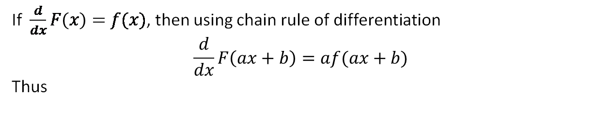
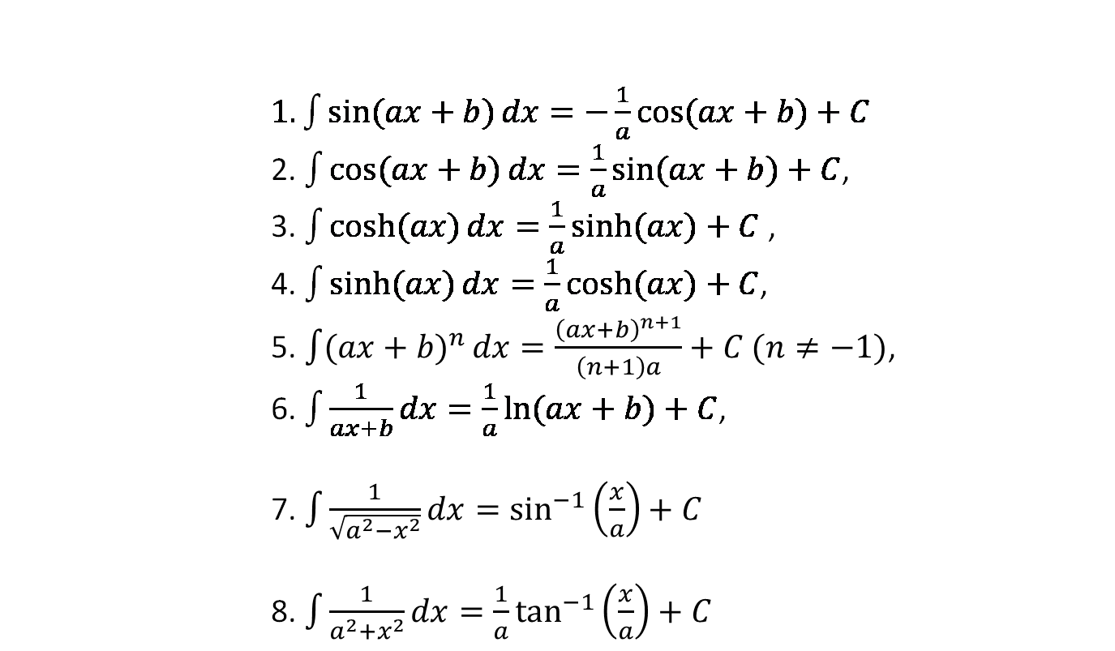
Useful Technique
If $\frac{d}{dx}F\left(x\right)=f(x)$, then using chain rule of differentiation
$$\frac{d}{dx}F\left(ax+b\right)=af(ax+b)$$
Thus
$1.\int{\sin{(ax+b)}dx}=−\frac{1}{a}\cos{(ax+b)}+C$
2. $\int{\cos{(ax+b)}dx}=\frac{1}{a}\sin{(ax+b)}+C$,
3. $\int{\cosh{(ax)}}dx=\frac{1}{a}\sinh{(ax)}+C$ ,
4. $\int{\sinh{(ax)}dx=\frac{1}{a}\cosh{(ax)}}+C$,
5. $\int{({ax+b)}^{n}}dx=\frac{{\left(ax+b\right)}^{n+1}}{\left(n+1\right)a}+C (n≠−1)$,
6. $\int{\frac{1}{ax+b}dx}=\frac{1}{a}\ln{(ax+b)}+C$,
7. $\int{\frac{1}{\sqrt{a^{2}−x^{2}}}dx}=\sin^{−1}\left(\frac{x}{a}\right)+C$
8. $\int{\frac{1}{a^{2}+x^{2}}dx}=\frac{1}{a}\tan^{−1}\left(\frac{x}{a}\right)+C$

Slide 6
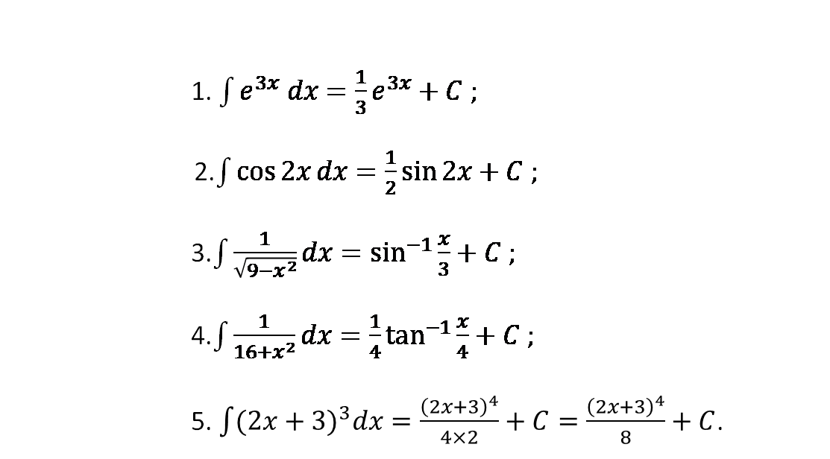
Example 1.1.2
1. $\int{e^{3x} dx}=\frac{1}{3}e^{3x}+C ;$
2.$\int{\cos{2x}}dx=\frac{1}{2}\sin{2x}+C ;$
3.$\int{\frac{1}{\sqrt{9−x^{2}}}dx}=\sin^{−1}{\frac{x}{3}}+C ;$
4.$\int{\frac{1}{16+x^{2}}dx}=\frac{1}{4}\tan^{−1}{\frac{x}{4}}+C ;$
5. $\int{(2x+{3)}^{3}dx=\frac{{\left(2x+3\right)}^{4}}{4×2}}+C=\frac{{\left(2x+3\right)}^{4}}{8}+C$.

Slide 7




Example set-1.1.1
1.
2.
3.

Slide 8


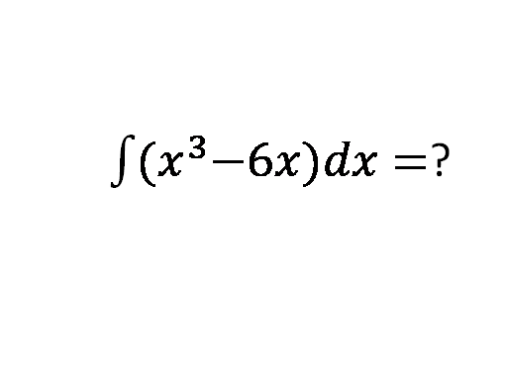
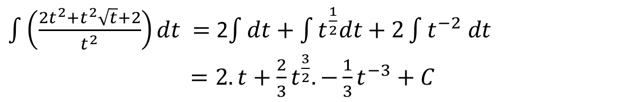
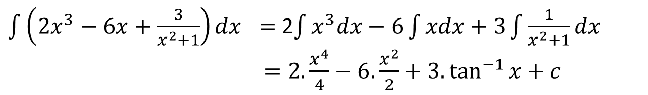
4.
$\int{\left({2x}^{3}−6x+\frac{3}{x^{2}+1}\right)dx} =$2$\int{x^{3}dx−6\int{xdx}+3\int{\frac{1}{x^{2}+1}dx}}$
$=2.\frac{x^{4}}{4}−6.\frac{x^{2}}{2}+3.\tan^{−1}{x+c}$
5.
$\int{\left(\frac{2t^{2}+t^{2}\sqrt{t}+2}{t^{2}}\right)dt} =$ 2$\int{dt+\int{t^{\frac{1}{2}}dt}+2\int{t^{−2} dt}}$
$=2.t+\frac{2}{3}t^{\frac{3}{2}}.−\frac{1}{3}t^{−3}+C$
6.
7.
$\int{{(x}^{3}−6x)dx}=$?

Slide 9
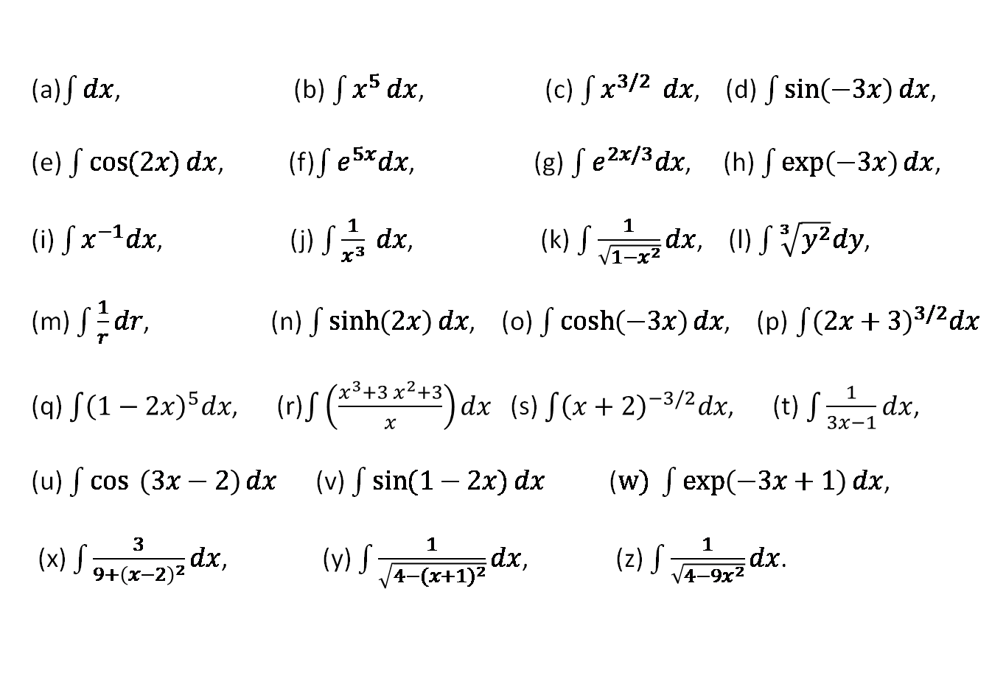
Exercise set-1.1.1
(a)$\int{dx}$, (b) $\int{x^{5 }dx}$, (c) $\int{x^{3/2 } dx}$, (d) $\int{\sin\left(−3x\right)dx}$,
(e) $\int{\cos{(2x)}dx}$, (f)$\int{e^{5x}dx}$, (g) $\int{e^{2x/3}dx}$, (h) $\int{\exp\left(−3x\right)dx}$,
(i) $\int{x^{−1}dx}$, (j) $\int{\frac{1}{x^{3}}} dx$, (k) $\int{\frac{1}{\sqrt{1−x^{2}}}dx}$, (l) $\int{\sqrt[3]{y^{2}}dy}$,
(m) $\int{\frac{1}{r}dr}$, (n) $\int{\sinh\left(2x\right)dx}$, (o) $\int{\cosh\left(−3x\right)dx}$, (p)$\int{{\left(2x+3\right)}^{3/2}dx}$
(q) $\int{{\left(1−2x\right)}^{5}dx}$, (r)$\int{\left(\frac{x^{3}+3 x^{2}+3}{x}\right)dx}$ (s) $\int{{\left(x+2\right)}^{−3/2}dx}$, (t)$\int{\frac{1}{3x−1}dx}$,
(u) $\int{\cos{ \left(3x−2\right)}dx}$ (v) $\int{\sin{(1−2x)}dx}$ ($w) \int{\exp\left(−3x+1\right)dx}$,
(x) $\int{\frac{3}{9+{\left(x−2\right)}^{2}}dx}$, (y) $\int{\frac{1}{\sqrt{4−({x+1)}^{2}}}dx}$, (z) $\int{\frac{1}{\sqrt{4−9x^{2}}}dx}$.

Slide 10
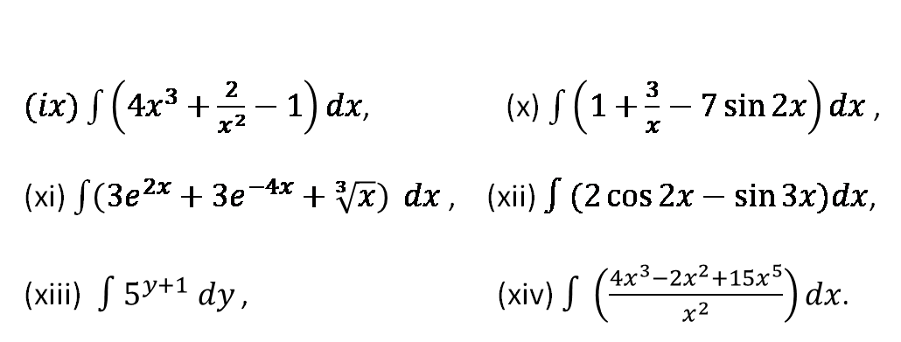
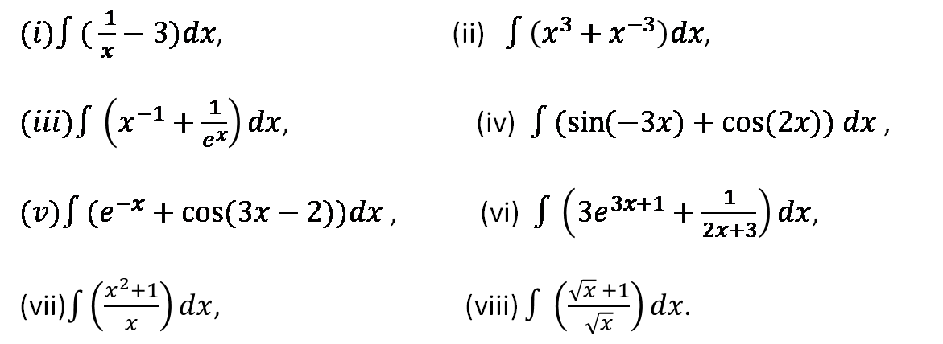
Exercise set-1.1.2
$(i)∫( \frac{ 1}{x}−3)dx$, (ii) $∫\left(x^{3}+x^{−3}\right)dx$,
$(iii)∫\left(x^{−1}+\frac{1}{e^{x}}\right)dx$, (iv)$∫(\sin{(−3x)+\cos{(2x)) dx }}$,
$(v)∫(e^{−x}+\cos{(3x−2))dx}$ , (vi) $∫\left(3e^{3x+1}+\frac{1}{2x+3}\right)dx$,
(vii)$\int{\left(\frac{x^{2}+1}{x}\right)}dx$, (viii) $∫\left(\frac{\sqrt{x} +1}{\sqrt{x}}\right)dx$.
$(ix)\int{\left(4x^{3}+\frac{2}{x^{2}}−1\right)}dx$, (x) $\int{\left(1+\frac{3}{x}−7\sin{2x}\right)dx }$,
(xi) $\int{\left(3e^{2x}+3e^{−4x}+\sqrt[3]{x}\right)} dx$, (xii) $∫(2\cos{2x−\sin{3x)dx}}$,
(xiii)$∫5^{y+1} dy$ , (xiv) $∫\left(\frac{4x^{3}−2x^{2}+15x^{5}}{x^{2}}\right)dx$.
Calculus– James Stewart - 8th edition
P-408 Ex # 5-18

Slide 11
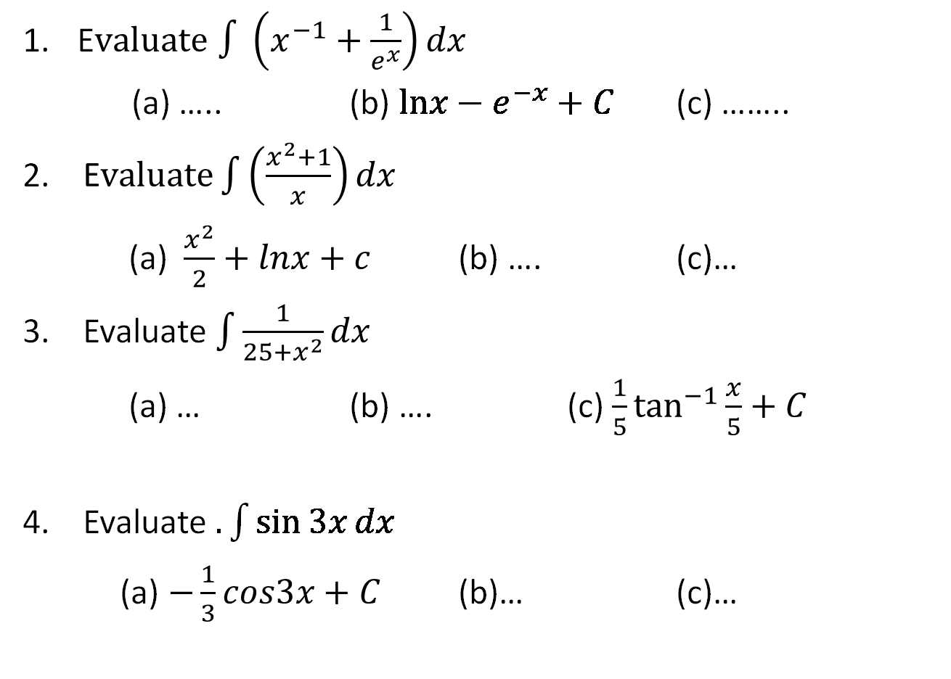
Sample MCQ
E$valuate$ $∫\left(x^{−1}+\frac{1}{e^{x}}\right)dx$
(a) ….. (b) $lnx−e^{−x}+C$ (c) ……..
2. $\text{E}valuate\int{\left(\frac{x^{2}+1}{x}\right)}dx$
(a) $\frac{x^{2}}{2}+lnx+c$ (b) …. (c)…
3. Evaluate $\int{\frac{1}{25+x^{2}}dx}$
(a) … (b) …. (c) $\frac{1}{5}\tan^{−1}{\frac{x}{5}}+C$
4. Evaluate $.\int{\sin{3x}}dx$
(a) $−\frac{1}{3}cos3x+C$ (b)… (c)…

Slide 12

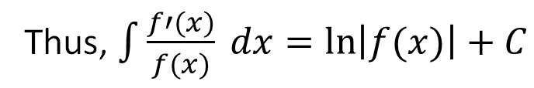


1.1.2 Integration by Substitution
If $u=g(x)$ is a differentiable function whose range is an interval $I$ and $f(x)$ is continuous on $I$ then
$$∫f\left(g\left(x\right)\right)g^{′}\left(x\right)dx=∫f(u)du$$
Where If $u=g(x)$ then $du=g^{′}\left(x\right)dx$
An integral of the form$\int{\frac{f′(x)}{f(x)} dx}$
Thus, $\int{\frac{f′(x)}{f(x)} dx=\ln\left|f(x)\right|+C}$

Slide 13
Example set 1.1.2
1.
2.

Slide 14
3.
4.
5.

Slide 15
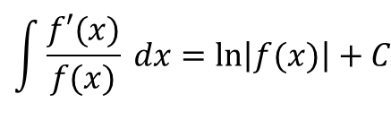
6.
$$\int{\frac{f′(x)}{f(x)} dx=\ln\left|f(x)\right|+C}$$
7.
8.
9.
10.

Slide 16
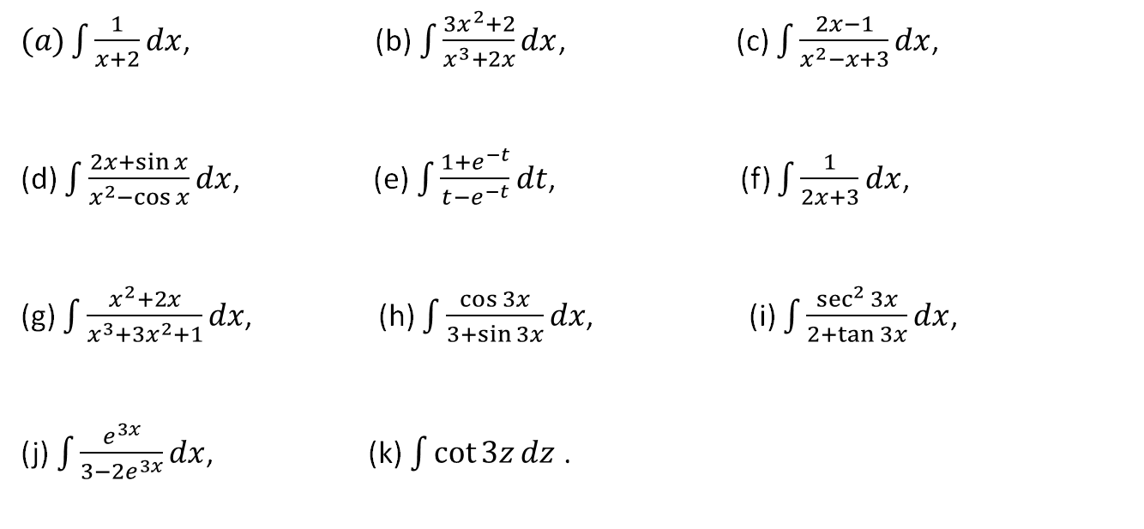
Exercise set-1.1.3
.
$(a)\int{\frac{1}{x+2}dx}$, (b) $\int{\frac{3x^{2}+2}{x^{3}+2x}dx}$, (c) $\int{\frac{2x−1}{x^{2}−x+3}dx}$,
(d) $\int{\frac{2x+\sin{x}}{x^{2}−\cos{x}}dx}$, (e) $\int{\frac{1+e^{−t}}{t−e^{−t}}dt}$, (f) $\int{\frac{1}{2x+3}dx}$,
(g) $\int{\frac{x^{2}+2x}{x^{3}+3x^{2}+1}dx}$, (h) $\int{\frac{\cos{3x}}{3+\sin{3x}}dx}$, (i) $\int{\frac{\sec^{2}{3x}}{2+\tan{3x}}dx}$,
(j) $\int{\frac{e^{3x}}{3−2e^{3x}}dx}$, (k) $\int{\cot{3z}}dz$ .

Slide 17
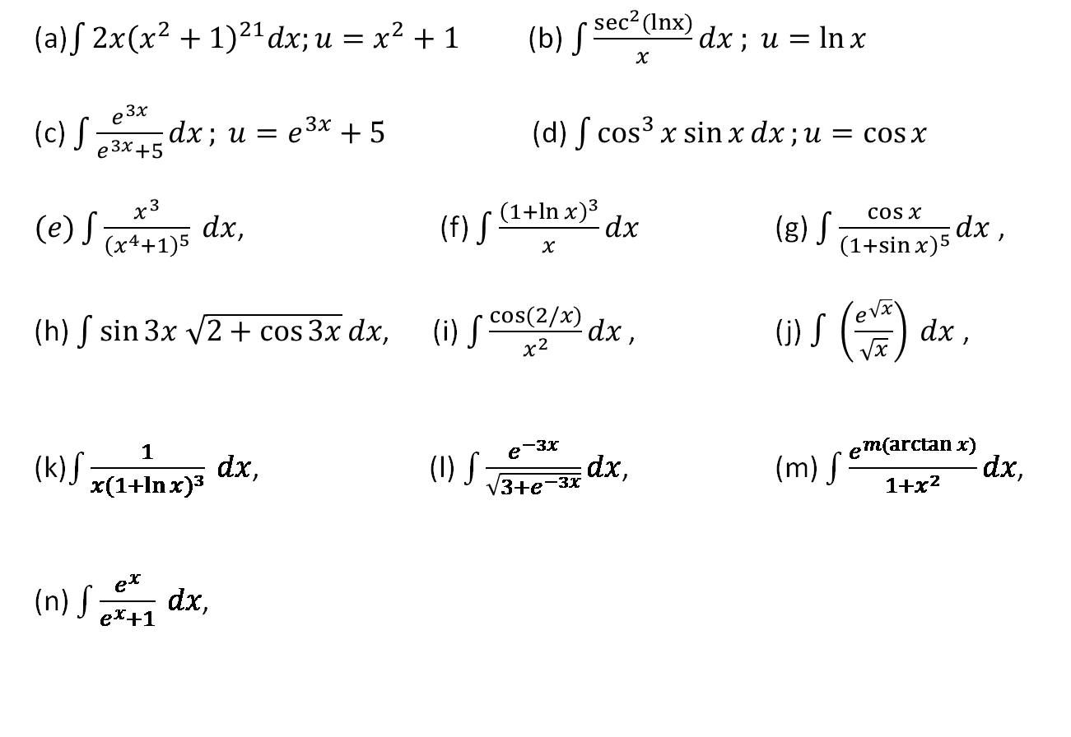
Exercise set-1.1.4
(a)$\int{2x{\left(x^{2}+1\right)}^{21}dx;u=x^{2}+1}$ (b)$\int{\frac{\sec^{2}(lnx)}{x}}dx ; u=\ln{x}$
(c) $\int{\frac{e^{3x}}{e^{3x}+5}dx}; u=e^{3x}+5$ (d) $\int{\cos^{3}{x}\sin{x}dx};u=\cos{x}$
$(e)\int{\frac{x^{3}}{{\left(x^{4}+1\right)}^{5}} dx}$, (f) $\int{\frac{{\left(1+\ln{x}\right)}^{3}}{x}dx}$ (g) $\int{\frac{\cos{x}}{{\left(1+\sin{x}\right)}^{5}}dx}$ ,
(h) $\int{\sin{3x \sqrt{2+\cos{3x}}}dx}$, (i)$\int{\frac{\cos{(2/x)}}{x^{2}}dx}$ , (j)$∫\left(\frac{e^{\sqrt{x}}}{\sqrt{x}}\right) dx$,
(k)$\int{\frac{1}{x{(1+\ln{x})}^{3}} dx}$, (l) $\int{\frac{e^{−3x}}{\sqrt{3+e^{−3x}}}dx}$, (m) $\int{\frac{e^{m(\arctan{x)}}}{1+x^{2}}}dx$,
(n) $\int{\frac{e^{x}}{e^{x}+1} dx}$,
.
Calculus– James Stewart - 8th edition
P-418 Ex # 7 - 13, 15, 18, 20, 21, 27, 31, 32, 43.

Slide 18

Sample MCQ
E$valuate\int{\frac{e^{x}}{e^{x}+1} dx}$
(a) ….. (b) $\ln\left(1+e^{x}\right)+C$ (c) ……..
$\text{E}valuate\int{\frac{x^{2}+2x}{x^{3}+3x^{2}+1}dx}\text{,}$
(a) $⁡3ln⁡(x^{3}+3x^{2}+1)+c$ (b) …. (c)…
3. Evaluate$\int{\frac{1}{x{(1+\ln{x})}^{3}} dx}$,
(a) … (b) …. (c) $−\frac{1}{2}{\left(1+lnx\right)}^{−2}+C$

Slide 19
1.2 Definite Integrals

Slide 20


1.2.1 Riemann and Trapezoidal Sum
Consider a function $f(x)$ which is defined (i.e. bounded) over the closed interval$[a, b]$.
Consider a partition P of $\left[a, b\right]$ into $n$ subintervals by the points
This partition corresponds to the subintervals
$$\left[x_{0},x_{1}\right], \left[x_{1},x_{2}\right], \left[x_{2},x_{3}\right], ∙ ∙ ∙ ,\left[x_{n−1},x_{n}\right]$$

Slide 21
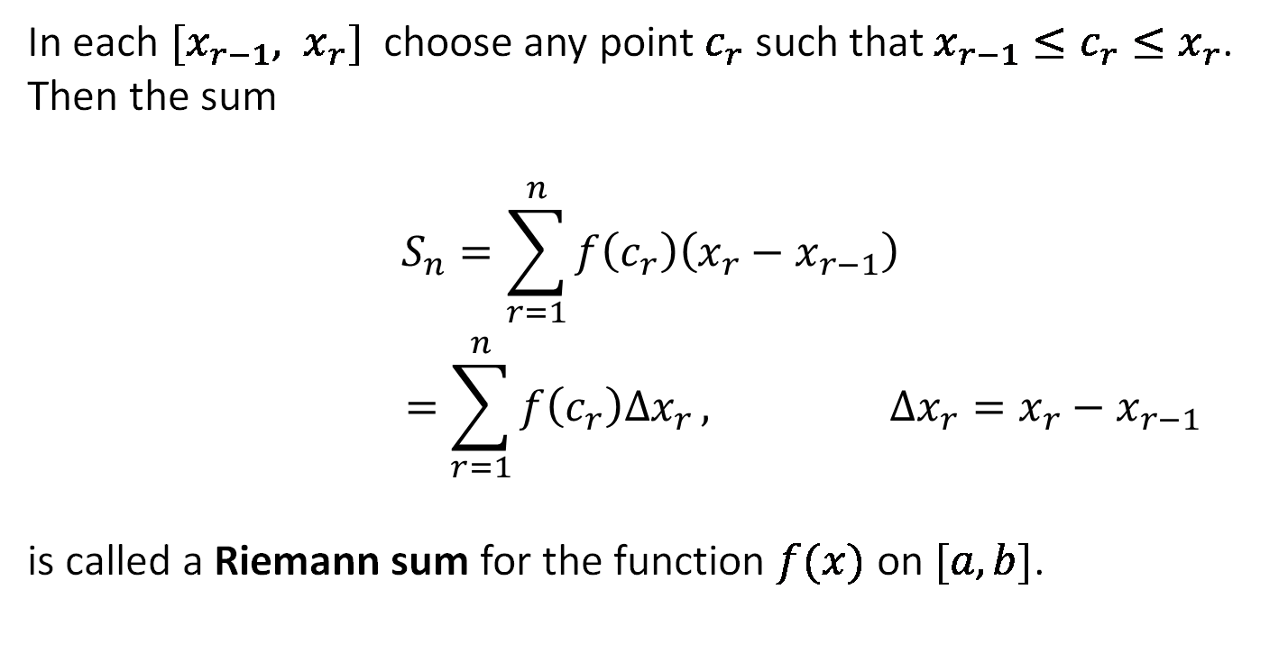
In each $[x_{r−1}, x_{r}]$ choose any point $c_{r}$ such that $x_{r−1}≤c_{r}≤x_{r}$. Then the sum
$$\begin{aligned}S_{n}=\sum_{r=1}^{n}{f\left(c_{r}\right)\left(x_{r}−x_{r−1}\right)} \\ =\sum_{r=1}^{n}{f\left(c_{r}\right)∆x_{r }, ∆x_{r}=x_{r}−x_{r−1}}\end{aligned}$$
is called a Riemann sum for the function $f(x)$ on $[a, b]$.

Slide 22
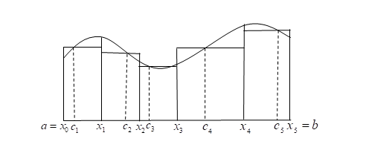
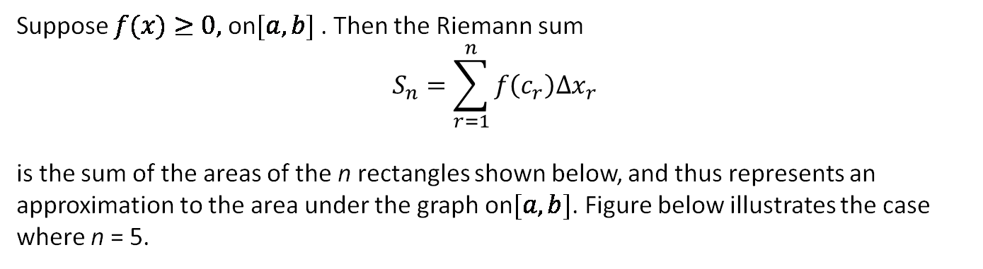
Suppose $f(x)≥0,$ on$[a,b]$ . Then the Riemann sum
$$\begin{aligned}S_{n}=\sum_{r=1}^{n}{f\left(c_{r}\right){∆x}_{r}} \\ \end{aligned}$$
is the sum of the areas of the n rectangles shown below, and thus represents an approximation to the area under the graph on$[a, b]$. Figure below illustrates the case where n = 5.

Slide 23
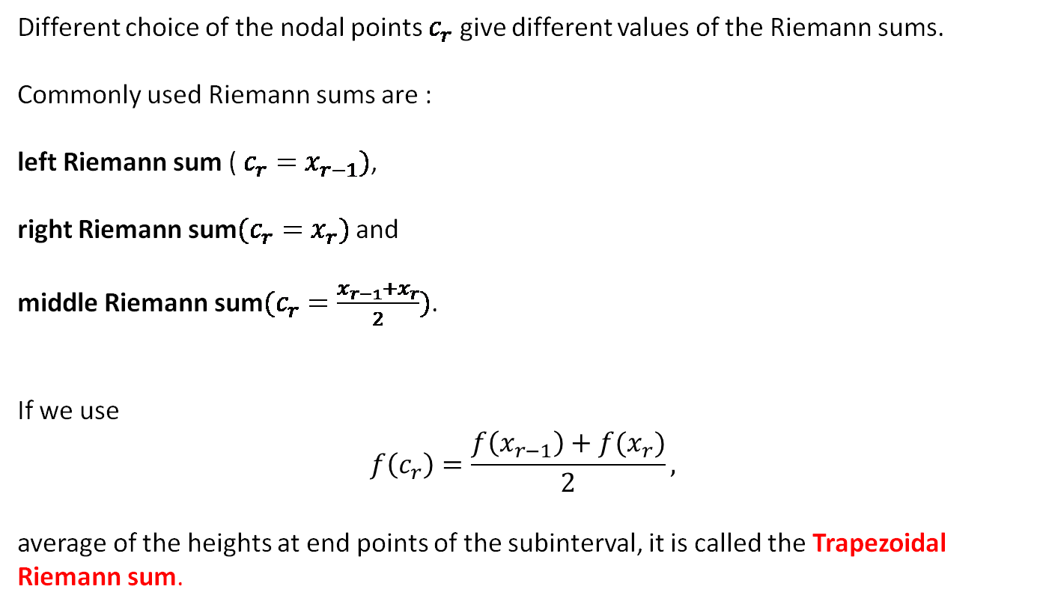
Different choice of the nodal points $c_{r}$ give different values of the Riemann sums.
Commonly used Riemann sums are :
left Riemann sum ( $c_{r}=x_{r−1})$,
right Riemann sum$(c_{r}=x_{r})$ and
middle Riemann sum$(c_{r}=\frac{x_{r−1}+x_{r}}{2})$.
If we use
$$f\left(c_{r}\right)=\frac{f\left(x_{r−1}\right)+f(x_{r})}{2},$$
average of the heights at end points of the subinterval, it is called the Trapezoidal Riemann sum.

Slide 24
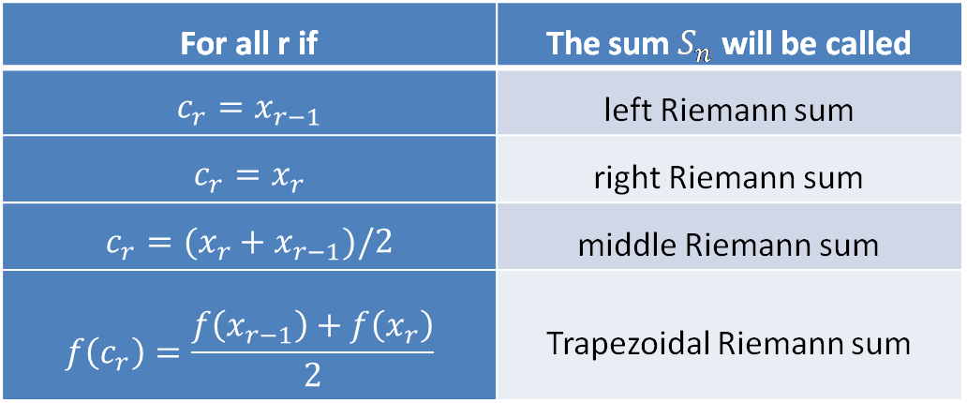
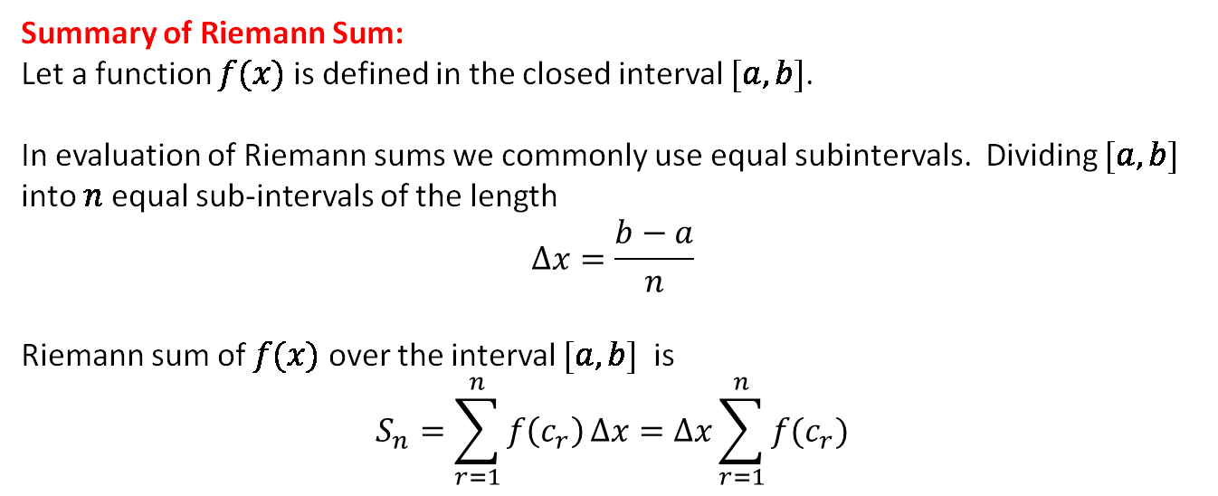
Summary of Riemann Sum:
Let a function $f(x)$ is defined in the closed interval $[a,b]$.
In evaluation of Riemann sums we commonly use equal subintervals. Dividing $[a,b]$ into $n$ equal sub-intervals of the length
$$∆x=\frac{b−a}{n}$$
Riemann sum of $f(x)$ over the interval $[a,b]$ is
$$S_{n}=\sum_{r=1}^{n}{f\left(c_{r}\right)}∆x=∆x\sum_{r=1}^{n}{f(c_{r})}$$
For all r if | The sum $S_{n}$ will be called
$$c_{r}=x_{r−1}$$ | left Riemann sum
$$c_{r}=x_{r}$$ | right Riemann sum
$$c_{r}=(x_{r}+x_{r−1})/2$$ | middle Riemann sum
$$f\left(c_{r}\right)=\frac{f\left(x_{r−1}\right)+f\left(x_{r}\right)}{2}$$ | Trapezoidal Riemann sum

Slide 25
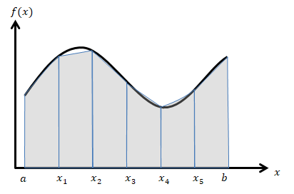
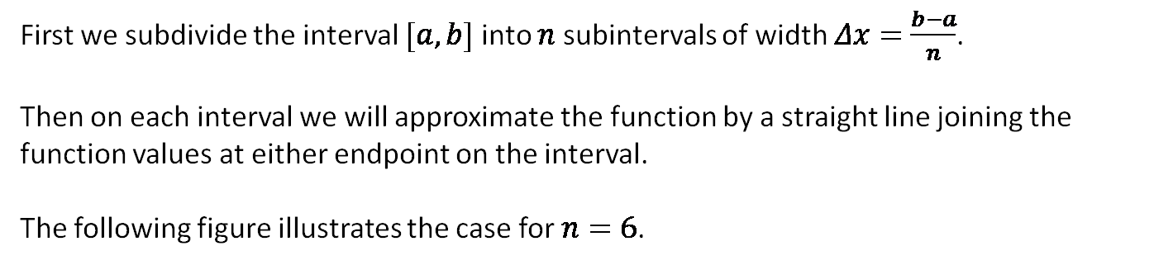
1.2.2 Numerical Integration (The Trapezoidal Rule)
First we subdivide the interval $[a,b]$ into $n$ subintervals of width $Δx=\frac{b−a}{n}$.
Then on each interval we will approximate the function by a straight line joining the function values at either endpoint on the interval.
The following figure illustrates the case for $n=6$.
Each of these shaded objects is a trapezoid (hence the rule’s name) and as we can see some of them do a very good approximation to the actual area under the corresponding segment of the curve.

Slide 26
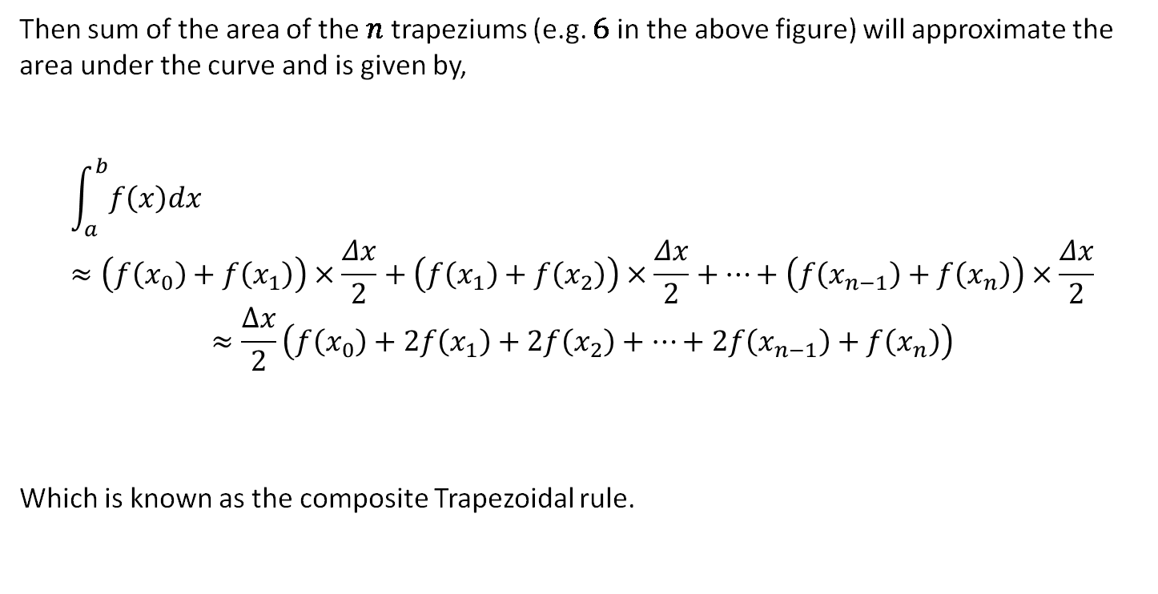
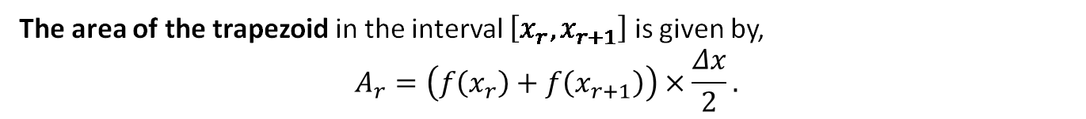
The area of the trapezoid in the interval $\left[x_{r},x_{r+1}\right]$ is given by,
$$A_{r}=\left(f\left(x_{r}\right)+f\left(x_{r+1}\right)\right)×\frac{Δx}{2}.$$
Then sum of the area of the $n$ trapeziums (e.g. $6$ in the above figure) will approximate the area under the curve and is given by,
$$\int_{a}^{b}{f\left(x\right)dx}≈\left(f\left(x_{0}\right)+f\left(x_{1}\right)\right)×\frac{Δx}{2}+\left(f\left(x_{1}\right)+f\left(x_{2}\right)\right)×\frac{Δx}{2}+…+\left(f\left(x_{n−1}\right)+f\left(x_{n}\right)\right)×\frac{Δx}{2}$$
$$≈\frac{∆x}{2}\left(f\left(x_{0}\right)+2f\left(x_{1}\right)+2f\left(x_{2}\right)+…+2f\left(x_{n−1}\right)+f\left(x_{n}\right)\right)$$
Which is known as the composite Trapezoidal rule.

Slide 27
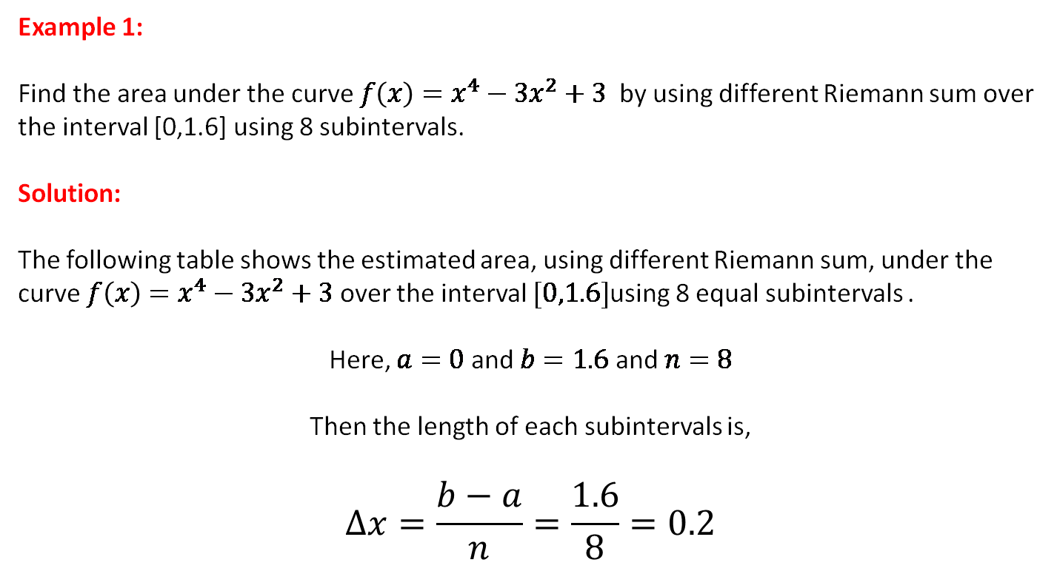
Example set 1.2.1
Example 1:
Find the area under the curve ${f\left(x\right)=x}^{4}−3x^{2}+3$ by using different Riemann sum over the interval [0,1.6] using 8 subintervals.
Solution:
The following table shows the estimated area, using different Riemann sum, under the curve ${f\left(x\right)=x}^{4}−3x^{2}+3$ over the interval $[0,1.6]$using 8 equal subintervals .
Here, $a=0$ and $b=1.6$ and $n=8$
Then the length of each subintervals is,
$$Δx=\frac{b−a}{n}=\frac{1.6}{8}=0.2$$

Slide 28
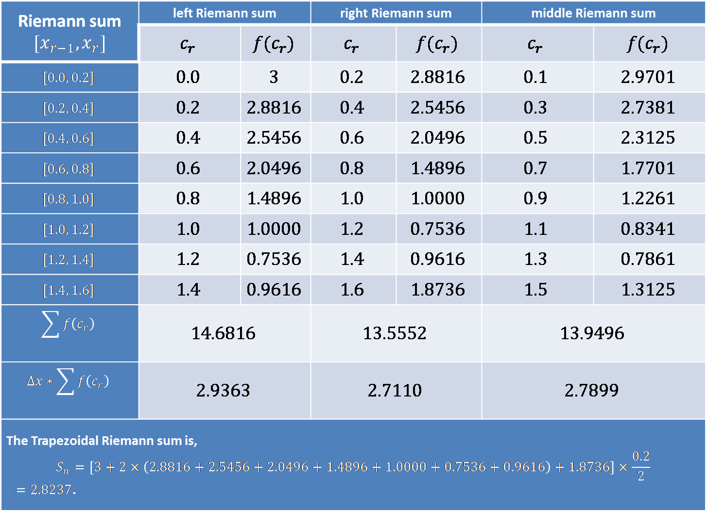
Riemann sum $$[x_{r−1},x_{r}]$$ | left Riemann sum |  | right Riemann sum |  | middle Riemann sum
 | $$c_{r}$$ | $$f(c_{r})$$ | $$c_{r}$$ | $$f(c_{r})$$ | $$c_{r}$$ | $$f(c_{r})$$
$$[0.0, 0.2]$$ | $$0.0$$ | $$3$$ | $$0.2$$ | $$2.8816$$ | $$0.1$$ | $$2.9701$$
$$[0.2, 0.4]$$ | $$0.2$$ | $$2.8816$$ | $$0.4$$ | $$2.5456$$ | $$0.3$$ | $$2.7381$$
$$[0.4, 0.6]$$ | $$0.4$$ | $$2.5456$$ | $$0.6$$ | $$2.0496$$ | $$0.5$$ | $$2.3125$$
$$[0.6, 0.8]$$ | $$0.6$$ | $$2.0496$$ | $$0.8$$ | $$1.4896$$ | $$0.7$$ | $$1.7701$$
$$[0.8, 1.0]$$ | $$0.8$$ | $$1.4896$$ | $$1.0$$ | $$1.0000$$ | $$0.9$$ | $$1.2261$$
$$[1.0, 1.2]$$ | $$1.0$$ | $$1.0000$$ | $$1.2$$ | $$0.7536$$ | $$1.1$$ | $$0.8341$$
$$[1.2, 1.4]$$ | $$1.2$$ | $$0.7536$$ | $$1.4$$ | $$0.9616$$ | $$1.3$$ | $$0.7861$$
$$[1.4, 1.6]$$ | $$1.4$$ | $$0.9616$$ | $$1.6$$ | $$1.8736$$ | $$1.5$$ | $$1.3125$$
$$\sum{f\left(c_{r}\right)}$$ | $$14.6816$$ |  | $$13.5552$$ |  | $$13.9496$$
$$Δx∗\sum{f\left(c_{r}\right)}$$ | $$2.9363$$ |  | $$2.7110$$ |  | $$2.7899$$
The Trapezoidal Riemann sum is, $$S_{n}=\left[3+2×\left(2.8816+2.5456+2.0496+1.4896+1.0000+0.7536+0.9616\right)+1.8736\right]×\frac{0.2}{2}$$ $=2.8237$.

Slide 29
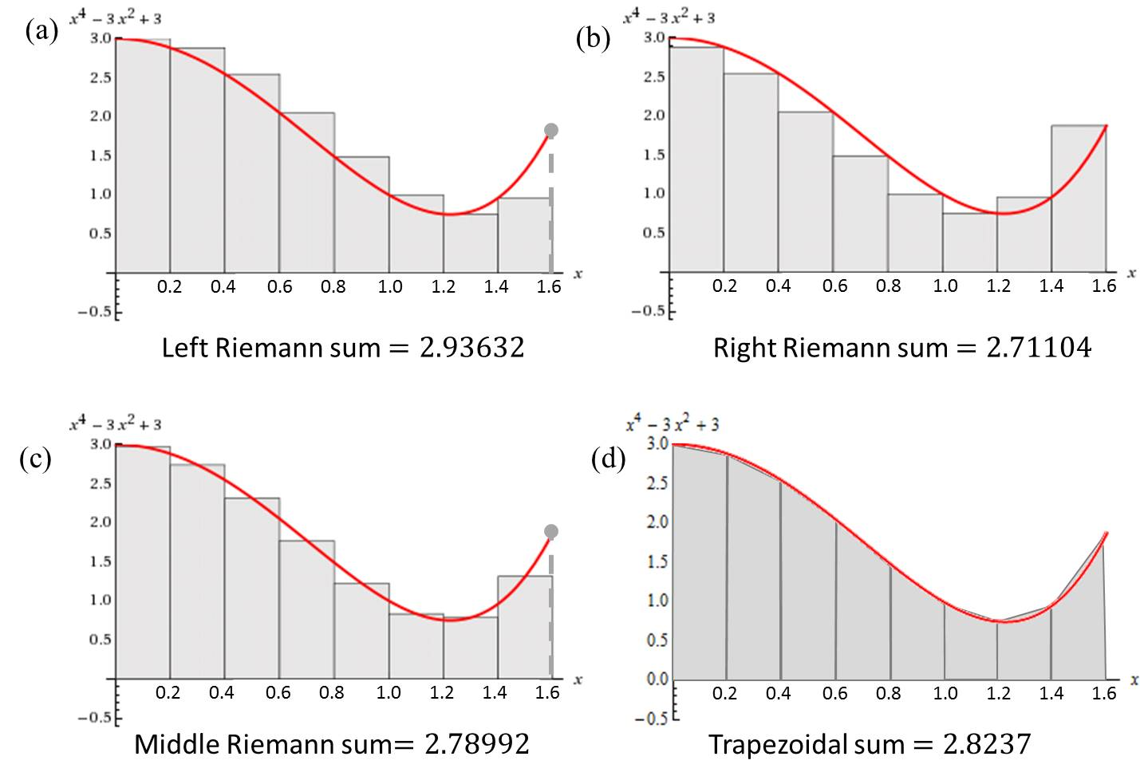
The following figures show the geometrical interpretation of the above Riemann sums,
Note that the exact value of the area is $2.80115$ which is calculated using the integration will be considered later.

Slide 30

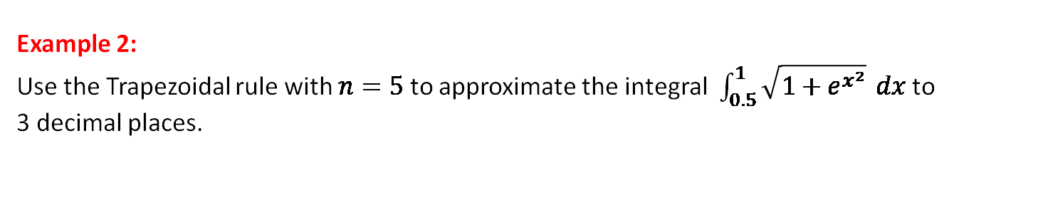
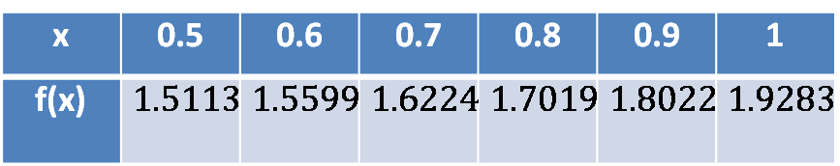
Example 2:
Use the Trapezoidal rule with $n=5$ to approximate the integral $\int_{0.5}^{1}{\sqrt{1+e^{x^{2}}}} dx$ to 3 decimal places.
Solution:
Here $a=0.5$, $b=1$ and $n=5$. So $∆x=\frac{1−0.5}{5}=0.1$and $f\left(x\right)=\sqrt{1+e^{x^{2}}}$.
Hence,
Using the Trapezoidal rule, we have
$$\int_{0.5}^{1}{\sqrt{1+e^{x^{2}}}} dx≈\frac{0.1}{2}[1.5113+2\left(1.5599\right)+2\left(1.6224\right)$$
$+2(1.7019)+2\left(1.8022\right)+1.9283]$
=$0.8406≈0.841$
x | 0.5 | 0.6 | 0.7 | 0.8 | 0.9 | 1
f(x) | $$1.5113$$ | $$1.5599$$ | $$1.6224$$ | $$1.7019$$ | $$1.8022$$ | $$1.9283$$

Slide 31
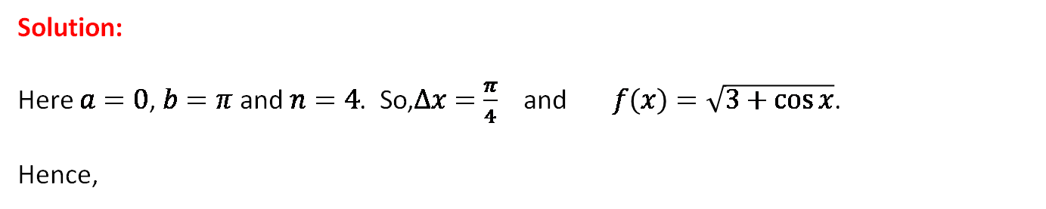
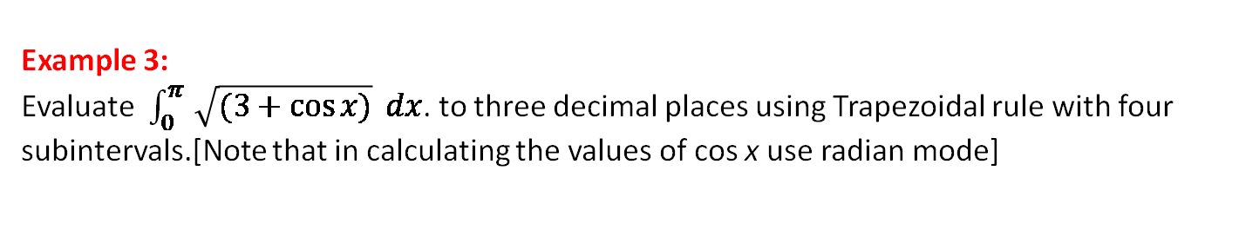
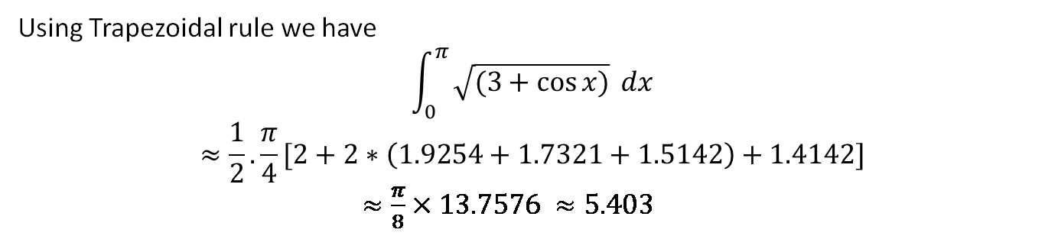
Example 3:
Evaluate $\int_{0}^{π }{\sqrt{(3+\cos{x)}}} dx$. to three decimal places using Trapezoidal rule with four subintervals.[Note that in calculating the values of cos x use radian mode]
Solution:
Here $a=0$, $b=π$ and $n=4$. So,$∆x=\frac{π}{4}$ and $f\left(x\right)=\sqrt{3+\cos{x}}$.
Hence,
x | 0 | π/4 | π/2 | 3π/4 | π
f(x) | 2.0000 | 1.9254 | 1.7321 | 1.5142 | 1.4142
Using Trapezoidal rule we have
$$\int_{0}^{π }{\sqrt{(3+\cos{x)}}} dx$$
$$≈\frac{1}{2}.\frac{π}{4}[2+2∗\left(1.9254+1.7321+1.5142\right)+1.4142]$$
$≈\frac{π}{8}×13.7576 ≈5.403$

Slide 32
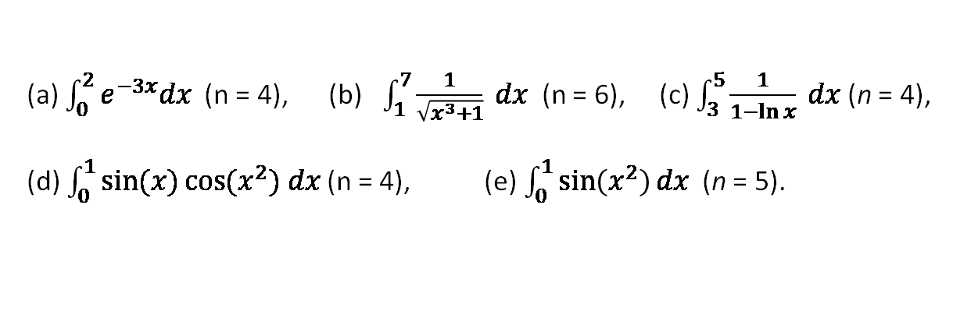
Exercise set 1.2.1
1.
Estimate the value the following integrals to 3 decimal places using ‘n’ subintervals of equal length using (i) left Riemann sum, (ii) right Riemann sum, (iii) middle Riemann sum and (iv) Trapezoidal rule.
(a) $\int_{0}^{2}{e^{−3x}dx }$(n = 4), (b) $\int_{1}^{7}{\frac{1}{\sqrt{x^{3}+1}} dx }$(n = 6), (c) $\int_{3}^{5}{\frac{1}{1−\ln{x}} dx }$(n = 4),
(d) $\int_{0}^{1}{\sin{(x)}\cos{{(x}^{2}) dx}}$ (n = 4), (e) $\int_{0}^{1}{\sin\left(x^{2}\right)dx}$ (n = 5).
2.
Calculus– James Stewart - 8th edition
P- 388 Ex # 1, 3, 7, 9
P- 524 Ex # 7, 8, 9 (n= 4, 6) LRS, RRS, MRS, TR

Slide 33
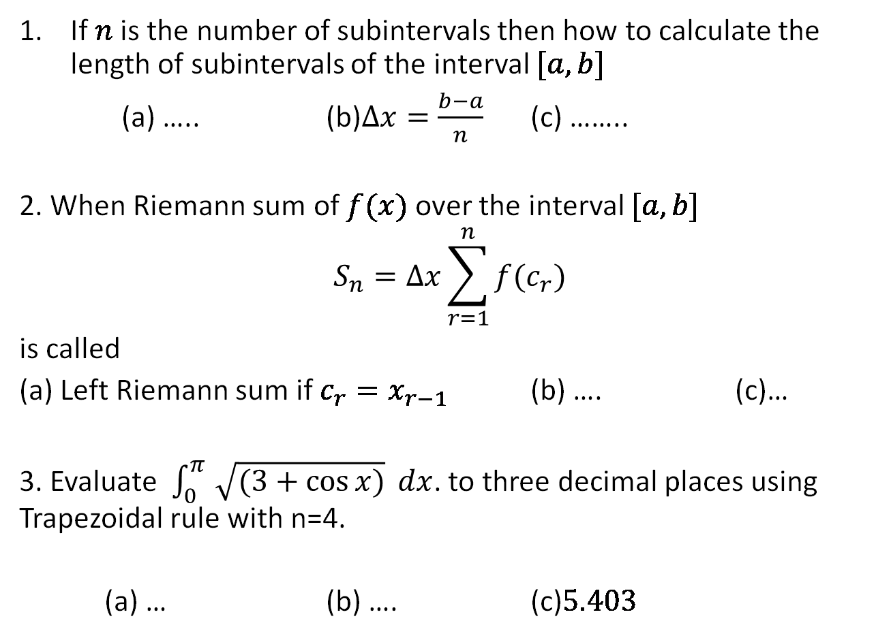
Sample MCQ
If $n$ is the number of subintervals then how to calculate the length of subintervals of the interval $[a,b]$
(a) ….. (b)$∆x=\frac{b−a}{n}$ (c) ……..
2. When Riemann sum of $f(x)$ over the interval $[a,b]$
$$S_{n}=∆x\sum_{r=1}^{n}{f(c_{r})}$$
is called
(a) Left Riemann sum if $c_{r}=x_{r−1}$ (b) …. (c)…
3. Evaluate $\int_{0}^{π }{\sqrt{(3+\cos{x)}}} dx$. to three decimal places using Trapezoidal rule with n=4.
(a) … (b) …. (c)$5.403$

Slide 34

1.2.3 The Fundamental Theorem of Calculus
Theorem: If $f\left(x\right)$ is a continuous function on $[a,b]$ and $f\left(x\right)$ is an indefinite integral of $f\left(x\right)$ then
where $∫f\left(x\right)dx=F(x)$.
Example:
1.
2.
3.

Slide 35
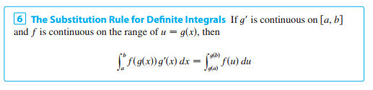
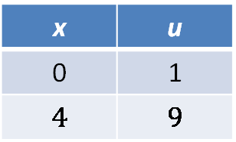
1.2.4 Substitution Rule For Definite Integrals
Example:
Changing Limit
x | u
0 | 1
$$4$$ | $$9$$

Slide 36
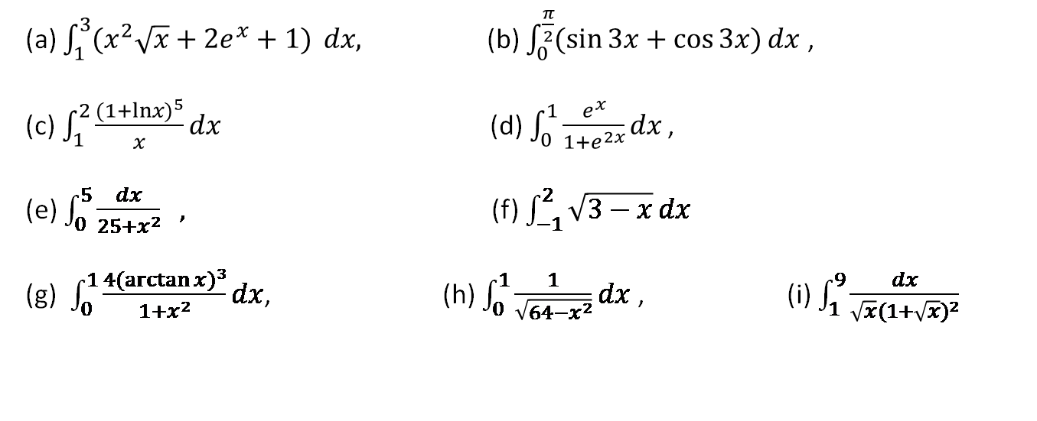
Exercise set 1.2.2
1.
(a) $\int_{1}^{3}{(x^{2}\sqrt{x}+{2e}^{x}+1)} dx,$ (b) $\int_{0}^{\frac{π}{2}}{(\sin{3x}+\cos{3x})}dx$,
(c)$\int_{1}^{2}{\frac{{(1+lnx)}^{5}}{x}}dx$(d)$\int_{0}^{1}{\frac{e^{x}}{1+e^{2x}}}dx$ ,
(e) $\int_{0}^{5}{\frac{dx}{25+x^{2}} } ,$ (f) $\int_{−1}^{2}{\sqrt{3−x}}dx$
(g) $\int_{0}^{1}{\frac{4{(\arctan{x})}^{3}}{1+x^{2}}dx}$, (h) $\int_{0}^{1}{\frac{1}{\sqrt{64−x^{2}}}dx}$ , (i) $\int_{1}^{9}{\frac{dx}{\sqrt{x}{(1+\sqrt{x})}^{2}}}$
2.
Calculus– James Stewart - 8th edition
P-400 Ex # 19, 23, 24, 25, 27, 29, 35, 43
P-409 Ex # 21 – 30
P- 419 Ex # 53, 54, 55, 59, 60, 70, 71

Slide 37

Sample MCQ
Evaluate $\int_{0}^{3}{\left(3x^{2}+6x+2\right)dx}$
(a) ….. (b)$60$ (c) ……..
2. Evaluate
(a) $\frac{26}{3}$ (b) …. (c)…
3. Evaluate $\int_{0}^{3}{\left(3x^{2}+6x+2\right)dy}$
(a)3($3x^{2}+6x+2$) (b) (c)

Slide 38
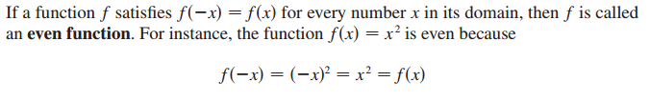

1.2.5 Even and Odd Function

Slide 39
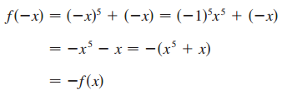


Example:
State whether the following functions are odd, even or neither.
Solution:
(a)
So, f(x) is an odd function
(b)
So, g(x) is an even function
(c)
So, h(x) is neither even nor odd function

Slide 40
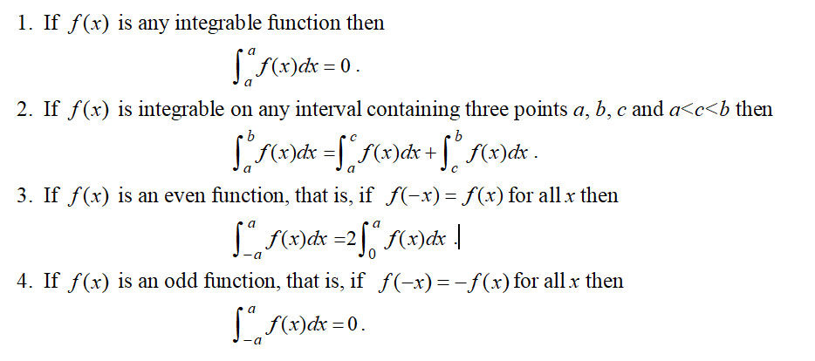
1.2.6 Some properties of definite integral

Slide 41
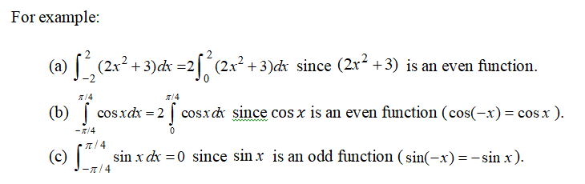

Slide 42
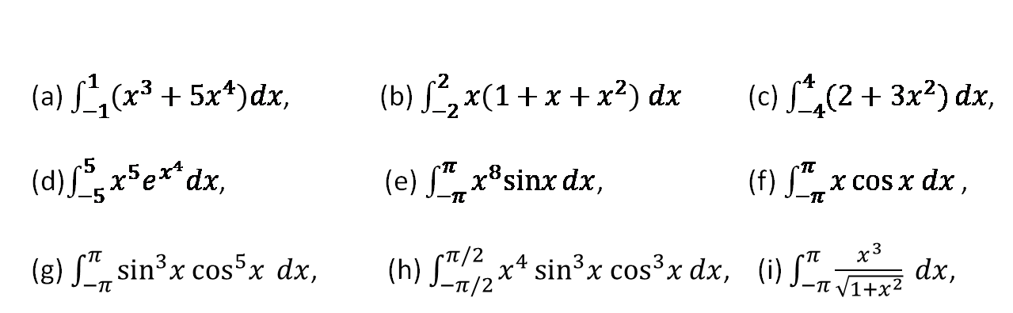
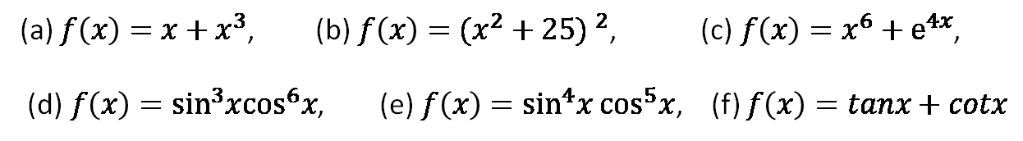
Exercise set 1.2.3
1.
State whether the following functions are odd, even or neither.
(a) $f\left(x\right)=x+x^{3}$, (b)$f\left(x\right)={(x^{2}+25) }^{2}$, (c)$f\left(x\right)=x^{6}+e^{4x}$,
(d)$f\left(x\right)=\sin^{3}x\cos^{6}x$, (e)$f\left(x\right)=\sin^{4}x\cos^{5}x$, (f) $f\left(x\right)=tanx+cotx$
2.
Evaluate the following integrals by using integral properties
(a) $\int_{−1}^{1}{\left(x^{3}+{5x}^{4}\right)dx}$, (b) $\int_{−2}^{2}{x\left(1+x+x^{2}\right) dx}$(c) $\int_{−4}^{4}{(2+{3x}^{2})}dx$,
(d)$\int_{−5}^{5}{x^{5}e^{x^{4}}dx}$, (e)$\int_{−π}^{π}{x^{8}sinx}dx$, (f)$\int_{−π}^{π}{x\cos{x dx}}$ ,
(g)$\int_{−π}^{π}{\sin^{3}x \cos^{5}x} dx$, (h)$\int_{−π/2}^{π/2}{x^{4}}\sin^{3}x \cos^{3}x dx$, (i) $\int_{−π}^{π}{\frac{x^{3}}{\sqrt{1+x^{2}}} dx}$,
3.
Calculus– James Stewart - 8th edition
P- 419 Ex # 61, 66, P-422 Ex # 22, 23

Slide 43

Sample MCQ
Which one is even function
(a) ….. (b)$f\left(x\right)=x^{4}+x^{2}$ (c) ……..
2. Which one is odd function
(a) $f\left(x\right)=sin2x$ (b) …. (c)…
3. Evaluate $\int_{−3}^{3}{\left(sin2y\right)dy}$
(a) 0 (b) (c)

